Slide 1
Introduction to Automation Testing

Slide 2
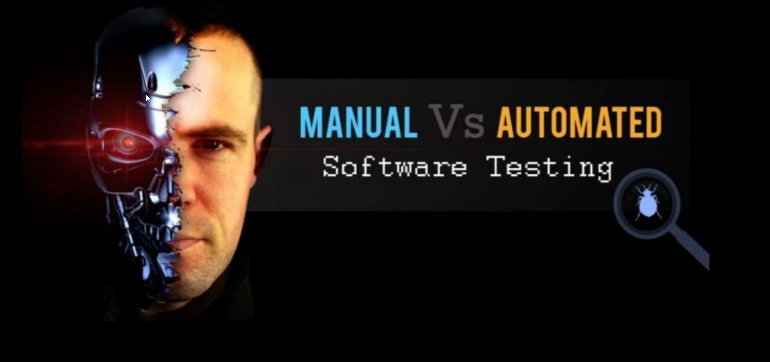
Notes:
As we progress into a digital future, it seems that speed is an aspect that is taken for granted in all transactions. From finding information about anything on the Internet, to interacting with a brand about a product complaint, users want answers in a jiffy. With the advances made on all fronts and the type of gadgets at hand, it has become a possibility and nearly taken for granted.
This kind of expectation seems to have spilled over to the world of software testing as well, with automated testing becoming quite popular and prevalent in most organizations. Does this mean that manual testing is no longer necessary at all? Let’s try to answer this question in detail.

Slide 3
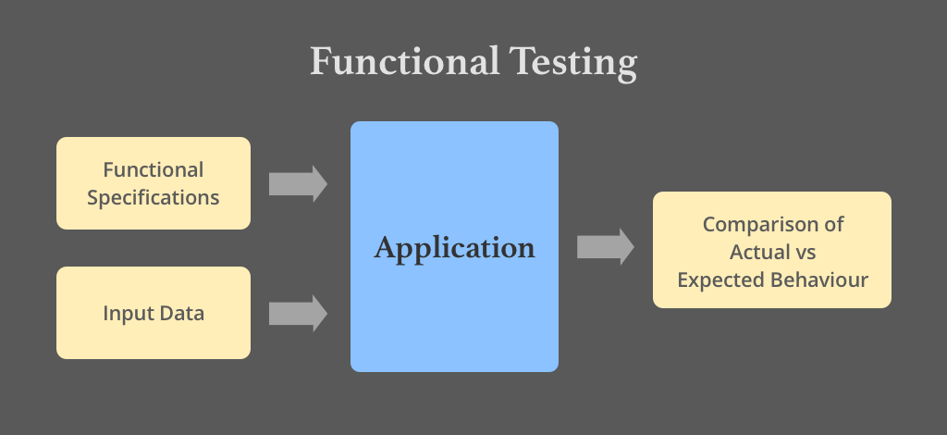

Slide 4
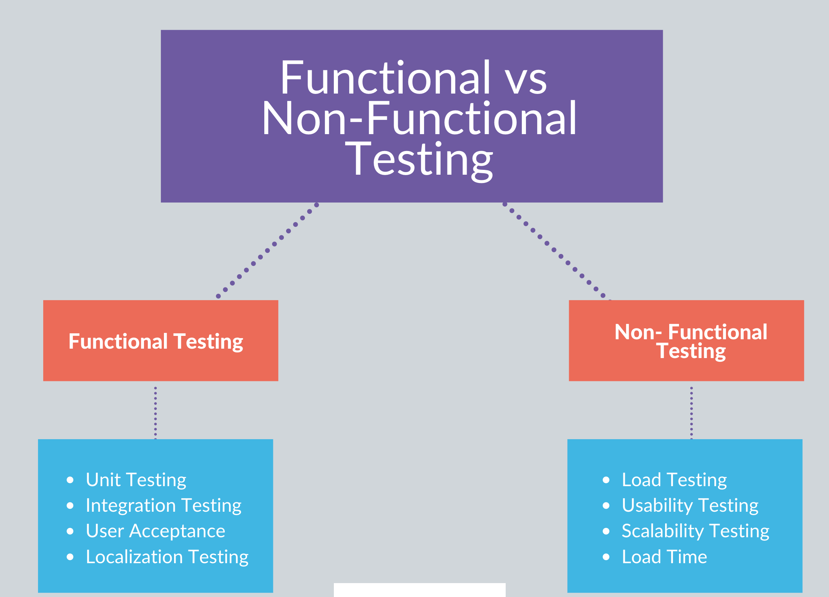

Slide 5
Regression Testing
Regression testing is re-running functional and non-functional tests to ensure that previously developed and tested software still performs after a change
When
  change in requirements and code is modified according to the requirement
  New feature that is added to the software
  Defect fixing done for the bugs already raised

Slide 6

Manual Testing
What ?
Procedure that involves testing a software manually by QA
Where ?
Small\Medium Project which under development
Why ?
Assure quality with low budget
Who ?
Testers with project functional knowledge

Slide 7
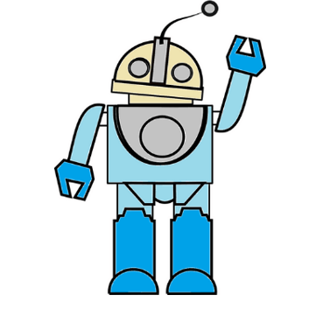
What ?
Automation testing is to write code/test scripts to automate test execution
Where ?
Use appropriate automation tools to develop the test scripts to validate the software
Why ?
The goal is to complete test execution in less amount of time
Who ?
Testers with basic programing knowledge
When ?
Not every time & everywhere

Slide 8
1. Processing Time
Automated testing is faster when directly compared to manual testing
Manual testing consumes human resources is time-consuming in general

Slide 9
2. Exploratory Testing
Automated testing does not allow for exploratory testing or random testing in general
Manual testing does allow for exploratory testing or random testing methodologies to be implemented

Slide 10
3. Initial Investment
Automated testing involves spending a bigger amount but it pays off well because the return on investment is better for long term
Manual testing involves spending a significantly smaller amount but ROI is comparatively low

Slide 11
4. Reliability
Automated testing is very robust and reliable as the task is carried out by various tools and scripts
Manual testing does not have a high rate of accuracy because it involves human error

Slide 12
5. UI Changes
Automated testing has a small disadvantage because scripts need to be changed completely if there is a UI change
Manual testing Can work fine with changes comparatively simple and quicker when compared

Slide 13
6. Resources
Automated testing calls for testing tools and automation engineers
Manual testing calls for investing in human resources

Slide 14
7. Value for money
Automated testing will work out if the test content volume is large
Manual testing will not be cost effective for high volume testing

Slide 15
8. Performance Testing
Automated testing allows tests like load testing, stress testing etc. which can be done very easily
Manual testing does not offer feasibility when performance testing is a main point of concern

Slide 16
9. Programming Knowledge
Automated testing involves a lot of programming, hence, it is must
Manual testing does not call for any requirement for programming knowledge

Slide 17
10. Use in DevOps
Automated testing helps in build verification and testing which are integral to the DevOps life cycle
Manual testing defeats the automated build principle of DevOps entirely and lowers efficiency

Slide 18
11. Ideal Use Case
Automated testing is very well suited for regression testing, load testing, highly repeatable functional test cases and more
Manual testing is suitable for AdHoc testing, exploratory testing and cases where there are frequent changes

Slide 19
12. Summary
Automated testing brings about efficiency numbers to the table unlike any other
Manual testing is one of those legacy systems which are still needed across a spectrum of cases

Slide 20
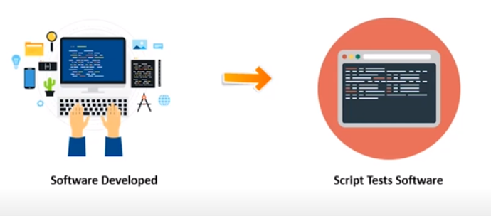

Slide 21
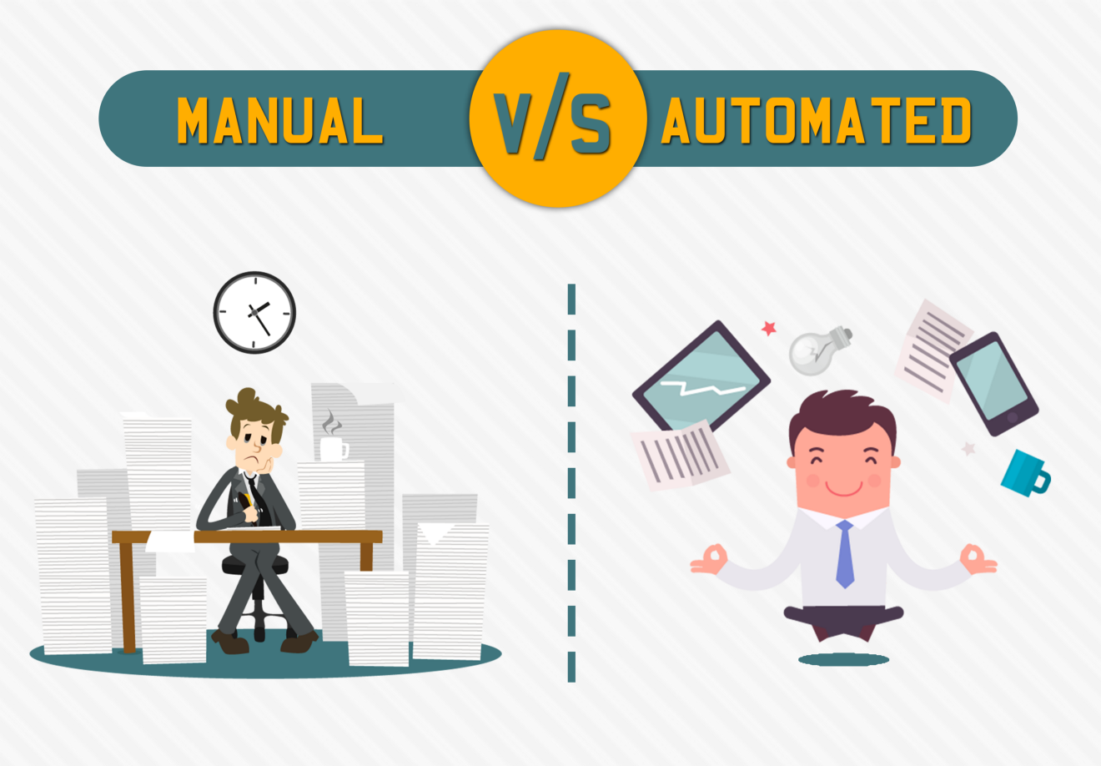

Slide 22
What is Programming?
Just like we use Hindi or English to communicate with each other, we use a Programming language to communicate with the computer
What is Python?
Python is a simple and easy-to-understand language that feels like reading simple English. This Pseudo code nature of Python makes it easy to learn and understandable for beginners

Slide 23
Features of Python
Easy to understand = Less development time
Free and open source
High-level language
Portable – works on Windows/Linux/Mac
+ Fun to work with :)
Prog write + Byte code (intermediate code) => machine language

Slide 24
Comments
Single line comment #
Multiline comment “””str””” ‘’’str’’’
Modules
Built-in modules - e.g. os, math
External Modules - e.g. flask
Pip
Package manager – to download and install external modules
pip install –U selenium - command to install external module
REPL – Read, Evaluate , Print , Loop

Slide 25
Practice programs
Practice program set 1:
1. Write a program to print * or # pattern in python.
#
##
###
####
#####
2. Use REPL and print the table of 10 using it.
3. Label the program written in problem 4 with comments.

Slide 26
Variables and datatypes
Variable – Container to store a value
Keywords – Reserved words in Python
Identifiers – class/function/variable name
Primarily there are the following data types in Python:
1. Integers 10, -20
2. Floating point numbers 10.50 55.5
3. Strings “Hello” ‘Hi’ “””Hello””” ‘’’Hi’’’
4. Booleans True False
5. None
Python is a fantastic language that automatically identifies the type of data for us.

Slide 27
Rules for defining a variable name
A variable name can contain alphabets, digits, and underscore.
  someName123 = “hello”
A variable name can only start with an alphabet and underscore.
A variable can’t start with a digit.
No white space is allowed to be used inside a variable name.
some_name = “Hello” #Valid
some name = “hello” #invalid
5. Variable names are case sensitive

Slide 28
Operators in Python
The following are some common operators in Python:
1. Arithmetic Operators (+, -, *, /, etc.)
2. Assignment Operators (=, +=, -=, *=, /=, etc.)
3. Comparison Operators (==, >=, <=, >, <, !=, etc.)
Logical Operators (and, or, not)

Slide 29
type() function
type function is used to find the data type of a given variable in Python.
a = 31
type(a) #class<int>
b = “31”
type(b) #class<str>

Slide 30
Typecasting
A number can be converted into a string and vice versa (if possible)
There are many functions to convert one data type into another.
Str(31) # ”31” Integer to string conversion
int(“32”) # 32 String to int conversion
float(32) #32.0 Integer to float conversion
Here “31” is a string literal, and 31 is a numeric literal.

Slide 31
input() function
This function allows the user to take input from the keyboard as a string.
a = input(“Enter name”) #if a is “harry”, the user entered harry

Slide 32
Practice set 2
1. Write a python program to print the contents of a directory using os module.
Search online for the function which does that.
Install an external module and use it to perform an operation of your interest.
  (e.g. play MP3 audio)
Write a Python program to add two numbers.
Write a Python program to find the remainder when a number is divided by Z(Integer).
Check the type of the variable assigned using the input() function.
Use a comparison operator to find out whether a given variable a is greater than b or not.
  (Take a=34 and b=80)
Write a Python program to find the average of two numbers entered by the user.
Write a Python program to calculate the square of a number entered by the user.

Slide 33
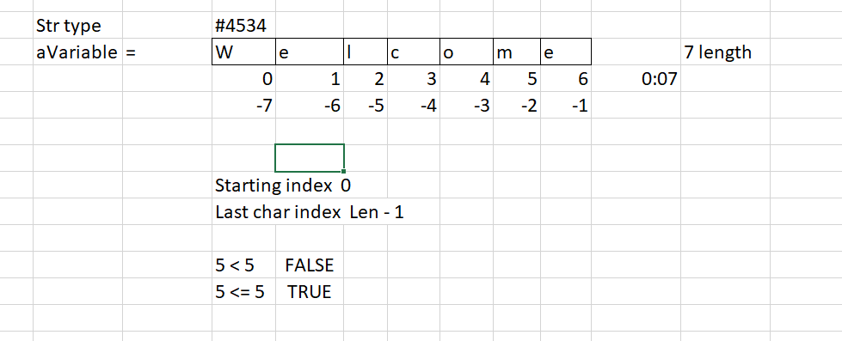
String Slicing
A string in Python can be sliced for getting a part of the string.
The index in a string starts from 0 to (length-1) in Python.
aVariable = “Welcome”

Slide 34
String Functions
1. len() function : It returns the length of the string.
len(‘harry’) #Returns 5
2. endswith(“rry”) : This function tells whether the variable string ends with the string “rry” or not.
  If string is “harry”, it returns for “rry” since harry ends with rry.
3. count(“c”) : It counts the total number of occurrences of any character.
4. capitalize() : This function capitalizes the first character of a given string.
find(word) : This function finds a word and returns the index of first occurrence of
    that word in the string.
replace(oldword, newword) : This function replaces the old word with the new word
in the entire string.

Slide 35
Escape Sequence Characters
Sequence of characters after backslash ‘\’ [Escape Sequence Characters]
Escape Sequence Characters comprises of more than one character
but represents one character when used within the string.
Examples: \n (new line), \t (tab), \’ (single quote), \\ (backslash), etc.
\ - backslash
/ - forward slash

Slide 36
Practice Set 3
1. Write a program to detect double spaces in a string. (count of double space or count of any char)
2. Write a program to format the following letter using escape sequence characters.
Dear Candidate,
We are delight to inform you that you have cleared all rounds of interview and we are extending offer to join us.
Thank you,
HR
3. From above solution (2) replace ‘Candidate’ with your name and HR name with some other name. By using some string operation function
4. Replace the double spaces from problem 3 with single spaces.

Slide 37
Lists
Python Lists are containers to store a set of values of any data type. (Mutable datatype)
colors = [‘Red’, ‘Yellow’, ‘Green’, 7, False]
List Indexing - A list can be index just like a string.
Friends[0] #Red
List Slicing
Friends[0:2] #Red, Yellow
List Methods
Consider the following list:
L1 = [1, 8, 7, 2, 21, 15] #len = 6
sort() – updates the list to [1,2,7,8,15,21]
reverse() – updates the list to [15,21,2,7,8,1]
append(8) – adds 8 at the end of the list
insert(3,8) – This will add 8 at 3 index and rest items will shift index by 1
pop(2) – It will delete the element at index 2 and return its value
by default it take default last index if not provided
remove(21) – It will remove 21 from the last

Slide 38
Tuples
A tuple is an immutable (can’t change or modified) data type in Python
Once defined, tuple elements can’t be manipulated or altered
a = () #It is an example of empty tuple
a = (1,) #Tuple with only one element needs a comma
a = (1, 7, 2) #Tuple with more than one element
Tuple parentheses are basically optional
a = 1, 7, 2 # is also valid tuple
An empty tuple can also be created with tuple() without an argument.
empty_tuple = ()

Slide 39
Tuple methods
count(1) – It will return the number of times 1 occurs in a.
2. index(1) – It will return the index of the first occurrence of 1 in a.

Slide 40
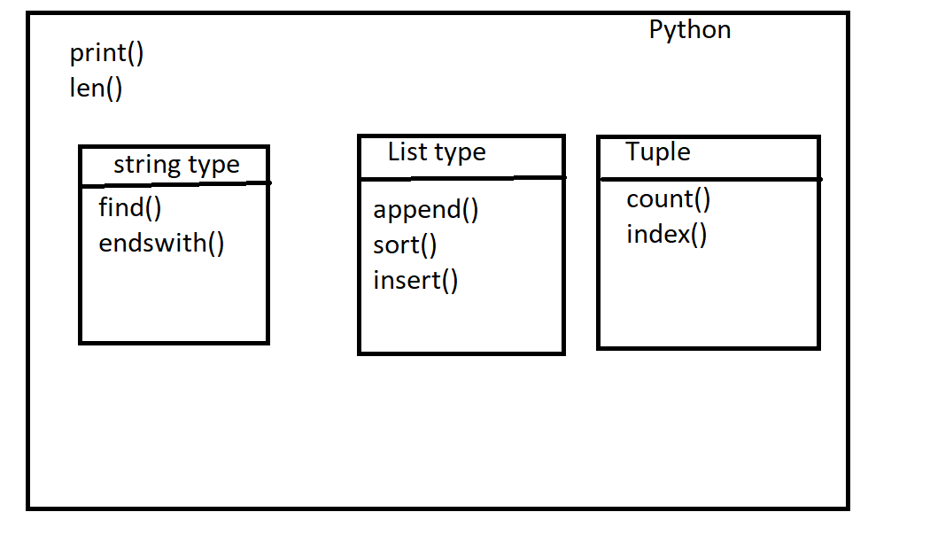

Slide 41
Dictionary
Dictionary is a collection of key-value pairs.
Properties of Python Dictionaries
1. It is unordered
2. It is mutable
3. It is indexed by key
4. It cannot contain duplicate keys but can contain duplicate values
a = {"key" : "value",
"harry": "code",
"marks" : "100",
"list": [1,2,9]
}
a["key"] # Prints value
a["list"] # Prints [1,2,9]

Slide 42
Dictionary Methods
1. items() : returns a list of (key,value) tuple.
2. keys() : returns a list containing dictionary’s keys.
3. update({“friend”: “Sam”}) : updates the dictionary with supplied key-value pairs.
get(“name”) : returns the value of the specified keys (and value is returned
e.g., “Harry” is returned here)
Get – will return value of specified key and if key not present then returns None
[“key”] – this will return value of specified key and if key is not present then gives error

Slide 43
Sets in Python
Set is a collection of non-repetitive elements
Properties of Sets
1. Sets are unordered # Elements order doesn’t matter
2. Sets are unindexed # Cannot access elements by index
There is no way to change items in sets - Immutable items
  Set is as whole mutable but inside items are immutable
4. Sets cannot contain duplicate values
# Add multiple elements in set by passing them as a tuple
sample_set.update((10, 20, 30))

Slide 44
Operations on Sets
Consider the following set:
S = {1,8,2,3}
Len(s) : Returns 4, the length of the set
remove(8) : Updates the set S and removes 8 from S
pop() : Removes an random element from the set and returns the element removed.
clear() : Empties the set S
union({8, 11}) : Returns a new set with all items from both sets. #{1,8,2,3,11}
intersection({8, 11}) : Returns a set which contains only items in both sets. #{8}
Note : If we specify empty set with {} then default type will be dictionary <class 'dict'>

Slide 45
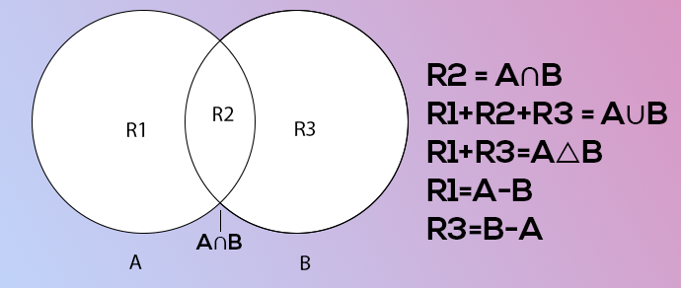

Slide 46
Conditional Expressions
The if statement is how you perform this sort of decision-making. It allows for conditional execution of a statement or group of statements based on the value of an expression.
if (condition1): // if condition 1 is true
print(“yes”)
elif (condition2): // if condition 2 is true
print(“No”)
else: // otherwise
print(“May be”)
a = 22
if (a>9):
print(“Greater”)
else:
print(“lesser”)

Slide 47
elif and else block are optional. You if you wish to use both, either or none which is fine.

Slide 48
Loops in Python
a loop is a sequence of instruction s that is continually repeated until a certain condition is reached.
Typically, a certain process is done, such as getting an item of data and changing it, and then some condition is checked such as whether a counter has reached a prescribed number.
Primarily there are two types of loops in Python
1. While loop
2. For loop

Slide 49
While Loop
The block keeps executing until the condition becomes false
i = 0
while i<5: # condition to be checked on every iteration
print(“Hello”)
i = i+1
Note: if the condition never becomes false, the loop keeps getting executed.

Slide 50
For Loop
A for loop is used to iterate through a sequence like a list, tuple, or string (iterables)
The syntax of a for loop looks like this:
l = [1, 7, 8]
for item in l:
print(item)

Slide 51
Range function in Python
The range function in python is used to generate a sequence of numbers.
We can also specify the start, stop, and step-size as follows:
range(start, stop, step_size)
• step size is usually not used with range()

Slide 52
For loop with else
An optional else can be used with a for loop if the code is to be executed when the loop exhausts.
Example:
l = [1, 7, 8]
for item in l:
print(item)
else:
print(“Done”) #This is printed when the loop exhausts!

Slide 53
Loop Statements
Break
  ‘break’ is used to come out of the loop when encountered. It instructs the program to – Exit the loop now
Continue
‘continue’ is used to stop the current iteration of the loop and continue with the next one. It instructs the program to “skip this iteration.”
3. Pass
pass is a null statement in python. It instructs to “Do nothing.”

Slide 54
Function
A function is a group of statements performing a specific task.
To make program modular
Reuse
The syntax of a function declaration looks as follows:
def func1():
print(“Hello”) # function body # function code
--------------------------------------------------------------------------------------------------------------
func1() #This is called function call

Slide 55
Types of Function
Built-in functions #Already present in Python
  Examples of built-in function includes len(), print(), range(), etc
User-defined functions #Defined by the user
The func1() function we defined is an example of a user-defined function.

Slide 56
Functions with arguments
A function can accept some values it can work with. We can put these values in the parenthesis. A function can also return values as shown below:
def greet(name):
gr = “Hello” + name
return gr
--------------------------------------------------------------
a = greet(“Credence”) #“Credence” is passed to greet in name
# a will now contain “Hello Credence”

Slide 57
Functions arguments with Default Parameter Value
We can have a value as the default argument in a function
For Example:
def greet(name=’Credence’):
#function body
-----------------------------------------------------------------------------------
greet() #Name will be ‘Credence’ in function body(default)
greet(“Credence”) #Name will be “Credence” in function body(passed)

Slide 58
Recursion
Recursion is a function which calls itself.
This function can be defined as follows:
def factorial(n):
if i == 0 or i == 1 : #Base condition which doesn’t call the function any further
return i
else:
return n*factorial(n-1) #Function calling itself

Slide 59
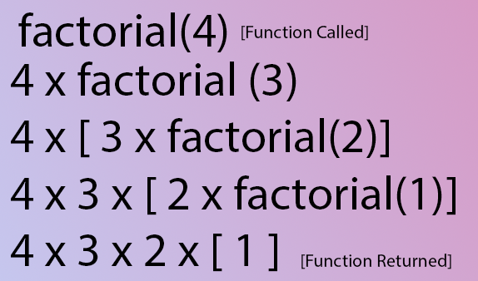
Recursion

Slide 60
Syntax Error VS Exceptions
Syntax Error: As the name suggests this error is caused by the wrong syntax in the code. It leads to the termination of the program.
Exceptions: Exceptions are raised when the program is syntactically correct, but the code resulted in an error.
Note: Exception is the base class for all the exceptions in Python.

Slide 61
Try and Except Statement – Catching Exceptions
Statements that can raise exceptions are kept inside the try clause and the statements that handle the exception are written inside except clause.
a = [1, 2, 3]
try:
print ("Second element = %d" %(a[1]))
# Throws error since there are only 3 elements in array
print ("Fourth element = %d" %(a[3]))
except:
print ("An error occurred")

Slide 62
Catching Specific Exception
A try statement can have more than one except clause, to specify handlers for different exceptions.
Specific exceptions handled in respective except block
All other exception handled in except: block
try:
# statement(s)
except ZeroDivisionError:
# statement(s)
except IndexError:
# statement(s)
except:
# statements(s)

Slide 63
else and finally block
else : Sometimes we want to run a piece of code when try was successful
finally : finally block will always executed regardless exception occurred or not
try:
a = 10
except:
print("Exception handled")
else:
print("Else block executed")
finally:
print("finally block executed")

Slide 64
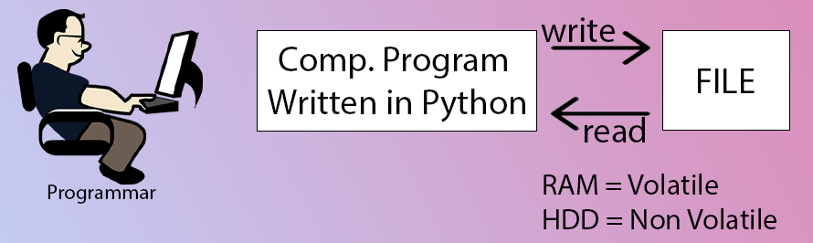
File I/O

Slide 65
Modes of opening a file
r – open for reading
w – open for writing, creates a new file if it does not exist or truncates the file if it exists.
x - Opens a file for exclusive creation. If the file already exists, the operation fails.
a – Opens a file for appending at the end of the file without truncating it.
Creates a new file if it does not exist.
+ -> Opens a file for updating (reading and writing)
‘rb’ will open for read in binary mode

Slide 66
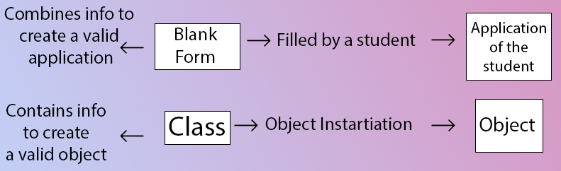
Class VS Object
OOPs - in oops Everything is considered as object
A class is a blueprint for creating objects. Is also collection of attributes/variable and functions/methods
An object is an instantiation of a class.
When class is defined, a template(info) is defined. Memory is allocated only after object instantiation.

Slide 67
Class VS Object
Instance/object attributes take preference over class attributes during assignment and retrieval.
objEmployee.attribute1 :
Is attribute1 present in the object?
Is attribute1 present in class?
If not present in both instance and class then error

Slide 68
__init__() constructor
__init__() is a special method which runs as soon as the object is created.
__init__() method is also known as constructor.
It takes self-argument and can also take further arguments.
The task of constructors is to initialize(assign values) to the data members(attributes) of the class when an object of the class is created.
Types of constructors:
default constructor
parameterized constructor

Slide 69
default constructor:
Doesn’t accept any arguments.
Its definition has only one argument which is a reference to the instance being constructed.
# default constructor
def __init__(self):
self.name = "Credence"
# creating object of the class
obj = Employee()

Slide 70
parameterized constructor
Accepts arguments
takes its first argument as a reference to the instance being constructed known as self and the rest of the arguments are provided by the programmer.
class Addition:
first = 0
second = 0
answer = 0
# parameterized constructor
def __init__(self, f, s):
self.first = f
self.second = s
# creating object of the class
# this will invoke parameterized constructor
obj = Addition(1000, 2000)

Slide 71
Static method
are bound to a class rather than its object
They do not require a class instance (object/variable) creation
they are not dependent on the state of the object
Static method knows nothing about the class and just deals with the parameters
@staticmethod #decorator to mark greet as a static method
@staticmethod #decorator to mark greet as a static method
def greet():
print(“Hello user”)

Slide 73
What is Automation Testing?
Automation testing uses the specialized tools to automate the execution of manually designed test cases without any human intervention.
Automation testing tools can access the test data, controls the execution of tests and compares the actual result against the expected result.
Consequently, generating detailed test reports of the system under test.
advantages for improving long-term efficiency of any software
Automation testing supports frequent regression testing
Automated testing has long been considered beneficial for big software organizations. Although, it is often thought to be too expensive or difficult for smaller companies to implement.
It provides rapid feedback to developers.
It provides unlimited iterations of test case execution.
It provides disciplined documentation of test cases.
Automated test generates customized defect reports.
Less error prone as compared to manual testing.

Slide 74
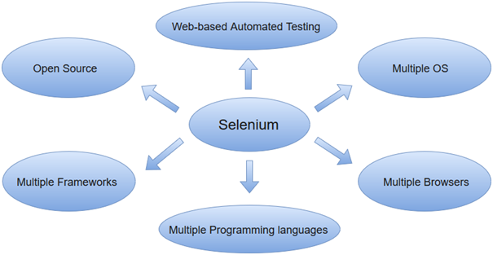
What is Selenium?
Most widely used open source Web UI (User Interface) automation testing suite
supports automation across different browsers, platforms and programming languages.

Slide 75
Selenium Suite
Four major components which include:
Selenium Integrated Development Environment (IDE)
  Firefox extension which provides record and playback functionality on test scripts
Selenium Remote Control (Now Deprecated)
  allows testers to write automated web application UI test. It also involves an HTTP proxy server which enables the browser to believe that the web application being tested comes from the domain provided by proxy server.
WebDriver
  successor to Selenium RC. Test scripts are written in order to identify web elements on web pages and then desired actions are performed on those elements
Selenium Grid
allows us to run our tests on different machines against different browsers in parallel.
follows the Hub-Node Architecture to achieve parallel execution of test scripts

Slide 76
Selenium getting started
pip install –U selenium # put on cmd
Get WebDrivers and put under python installed directory
Chrome: https://sites.google.com/a/chromium.org/chromedriver/downloads
      https://sites.google.com/chromium.org/driver/
Edge: https://developer.microsoft.com/en-us/microsoft-edge/tools/webdriver/
Firefox: https://github.com/mozilla/geckodriver/releases
Safari: https://webkit.org/blog/6900/webdriver-support-in-safari-10/

Slide 77
Import webdriver
  from selenium import webdriver
Initialize driver or get browser driver
driver = webdriver.Chrome() # for chrome
driver = webdriver.Ie() # for IE browser

Slide 78
Testing demo sites
https://seleniumbase.io/demo_page
https://the-internet.herokuapp.com/
http://www.dhtmlgoodies.com/scripts/drag-drop-custom/demo-drag-drop-3.html

Slide 79
Basic Commands
Open website or visit URL
  driver.get("https://facebook.com/") # open url or visit url
Capturing title of page
  driver.title
Capture Url of page
  driver.current_url
Closing and quitting browsers
driver.close() # close currently focused browser
driver.quit() #close all browers opened by script

Slide 80
Navigation Commands
visit previous url OR Back button on browser
driver.back() # visit previous url
Forward button on browser
  driver.forward()

Slide 81
Element Locater
Get/locate element by id
  driver.find_element_by_id("txtUsername")
  OR
  driver.find_element(By.ID, “txtUsername")
Get/locate element by name
  driver.find_element_by_name("txtUsername")
  OR
  driver.find_element(By.NAME, “txtUsername")
Get/locate element by class name
  driver.find_element_by_className("txtUsername")
  OR
  driver.find_element(By.ID, “txtUsername")

Slide 82
Element Locater
Get/locate element by XPATH
  driver.find_element_by_xpath("//*[@id='origin']/span/input")
  OR
  driver.find_element(By.XPATH, “txtUsername")
What is XPATH –
  XPath is the language used for locating nodes in an XML document.
  main reasons for using XPath is when you don’t have a suitable id or name attribute for the element you wish to locate.

Slide 83
Read value from input field
Read value
row = driver.find_element_by_id("myTextInput2").get_attribute("value")
Clear value
  driver.find_element_by_id("myTextInput2").clear()

Slide 84
Conditional Commands
Check element is displayed or not
  user_ele = driver.find_element_by_name(“userName”)
  user_ele .is_displayed() # returns true false
Check element is enabled or not
  user_ele = driver.find_element_by_name(“userName”)
  user_ele .is_enabled() # returns true false
Check element is selected or not
  user_ele = driver.find_element_by_name(“userName”)
  user_ele .is_selected() # returns true false

Slide 85
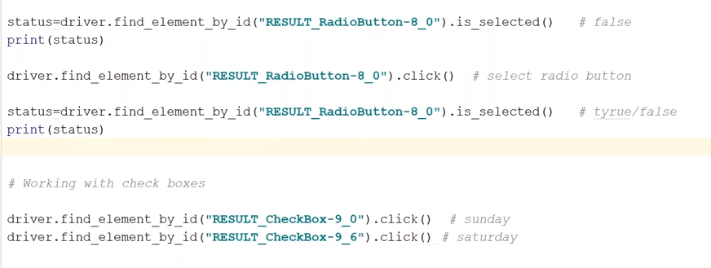
Radio button and Checkbox

Slide 86
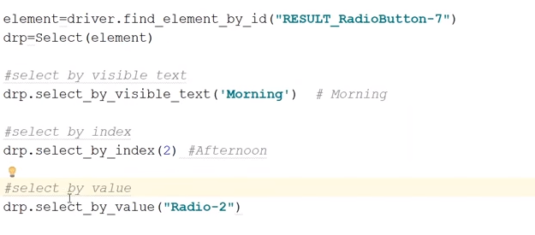
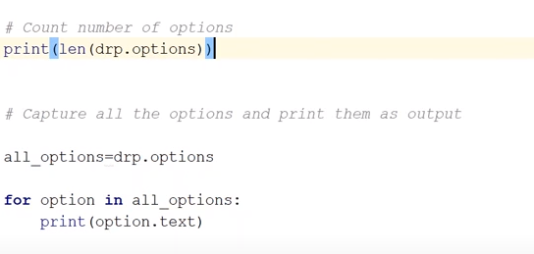
Dropdown control

Slide 87
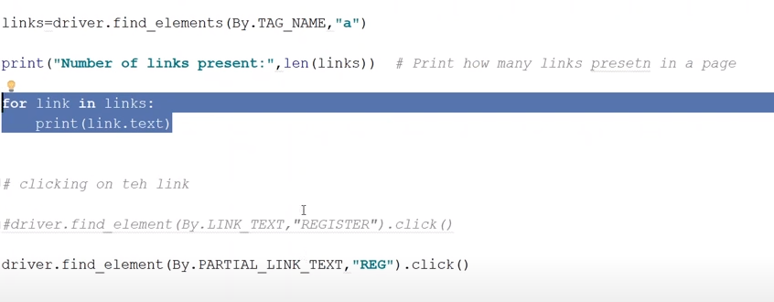
Link control

Slide 88
Alert control
Operation or handle popup alert
driver.switch_to.alert().accept()
- closes alert window using OK button
driver.switch_to.alert().dismiss()
-closes alert by using cancel button

Slide 89
Frame

Slide 90
Browser handle
Handle - Unique ID for browser window
driver.current_window_handle
gives unique id for current or parent browser window
driver.window_handles
returns all the handle values of opened browser windows
we can iterate list using loop for get particular window
driver.switch_to.window(handle)
to switch between multiple browser window

Slide 91
Implicit wait
An implicit wait tells WebDriver to poll the DOM for a certain amount of time when trying to find any element (or elements) not immediately available.
The default setting is 0 (zero). Once set, the implicit wait is set for the life of the WebDriver object.
from selenium import webdriver
driver = webdriver.Firefox()
driver.implicitly_wait(10) # seconds
driver.get("http://somedomain/url_that_delays_loading")
myDynamicElement = driver.find_element_by_id("myDynamicElement")

Slide 92
Explicit wait
An explicit wait is a code you define to wait for a certain condition to occur before proceeding further in the code
There are some convenience methods provided that help you write code that will wait only as long as required.
element = WebDriverWait(driver, 10).until(
EC.presence_of_element_located((By.ID, "myDynamicElement"))
)

Slide 93
from selenium import webdriver
from selenium.webdriver.common.by import By
from selenium.webdriver.support.ui import WebDriverWait
from selenium.webdriver.support import expected_conditions as EC
driver = webdriver.Firefox()
driver.get("http://somedomain/url_that_delays_loading")
try:
element = WebDriverWait(driver, 10).until(
EC.presence_of_element_located((By.ID, "myDynamicElement"))
)
finally:
driver.quit()

Slide 94
List of expected conditions commonly used in explicit wait
title_contains
visibility_of_element_located
presence_of_element_located
title_is
visibility_of
element_selection_state_to_be
presence_of_all_elements_located
element_located_to_be_selected
alert_is_present
element_located_selection_state_to_be
element_to_be_clickable
invisibility_of_element_located
frame_to_be_available_and_switch_to_it
text_to_be_present_in_element_value
text_to_be_present_in_element
element_to_be_selected

Slide 95
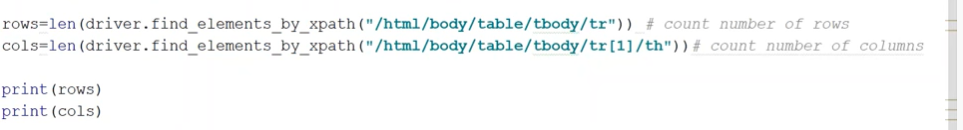
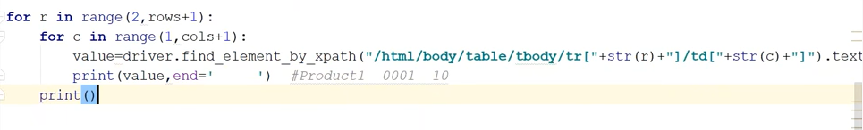
Table
Table is collection of rows and columns

Slide 96
Scrolling page
Scroll down the page by pixel
driver.execute_script(“window.scrollBy(0,1000)”, “")
Scroll down the page till element found
  element = driver.find_element(By.ID, "id")
  driver.execute_script(“arguments[0].scrollIntoView();”, element)
  # element is actual element of page located with any selector
Scroll to end of page
  driver.execute_script(“window.scrollBy(0, document.body.scrollHeight)”)

Slide 97
Mouse Action
  Module - from selenium.webdriver import ActionChains
MouseHover
actions = ActionChains(driver)
actions.move_to_element(firstElement). move_to_element(secondElement).click().perform()
#until you call perform() click operation will not happen
Double click
actions = ActionChains(driver) # create instance/object of ActionChain
actions.double_click(element).perform()

Slide 98
Mouse Action
  Module - from selenium.webdriver import ActionChains
Right Click
actions = ActionChains(driver)
action.context_click(buttonElement).perform()
Drag and Drop
actions = ActionChains(driver)
actions.drag_and_drop(source_element, target_element).perform()

Slide 99
Upload and Download
Upload file
  element.send_keys(file_path)
Download file
  element.click()

Slide 100
Excel Operations
Read data from file
Write data to file
Install below module/package
  pip install openpyxl

Slide 101
Screenshot
driver.Save_screenshot(‘filename’)
driver.Get_screenshot_as_file(‘filename’) #filename could be any name given to file. If you provide file name with full path then file will be stored at location other wise will be at current working directory

Slide 102
Logging
Write logs into file for future reference
Logs need to debug or find what went right what went wrong
With logs we can easily analyze errors or failures
Logging is very useful tool in a programmer’s toolbox. It can help you develop a better understanding of the flow of a program and discover scenarios that you might not even have thought of while developing
Log Levels
  DEBUG
  INFO
  WARNING
  ERROR
  CRITICAL

Slide 103
Logging
Import logging
logging.debug(“This is debug msg”)
logging.info(“This is info msg”)
logging.warning(“This is warning msg”)
logging.error(“This is error msg”)
logging.critical(“This is critical msg”)
Default logging setting is “warning”

Slide 104
